Slide 1
Diversity, Equity and Inclusion Team
Plainfield Public Schools
March 4th 2023

Slide 2
Who is in the room?
Introduction of members

Slide 3
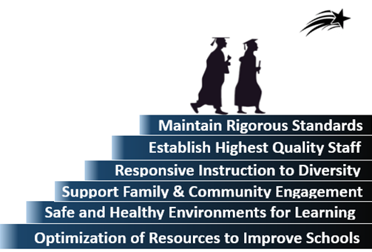
Mission
To Prepare ALL Students To Lead Safe and Healthy Lives
With The Skills to Become Productive Members
Of the Community & the Workforce

Slide 4
Purpose of Plainfield DEI Team
Support District Mission, Vision, and Core Values
Develop Policies and procedures for Plainfield schools
Provide Professional Development for staff
Identify and understand root causes of inequities that may exist within and across communities
Support the social and emotional needs of all learners
Develop a plan and process to address inequities by
Explore differences in cohort achievement.
Review access to programs among cohorts.
Examine racial disparities among cohorts.
Provide opportunities for staff development

Slide 5
DIVERSITY
& INCLUSION PLANNING TOOLKIT
DEI Planning Toolkit · 1

Slide 6
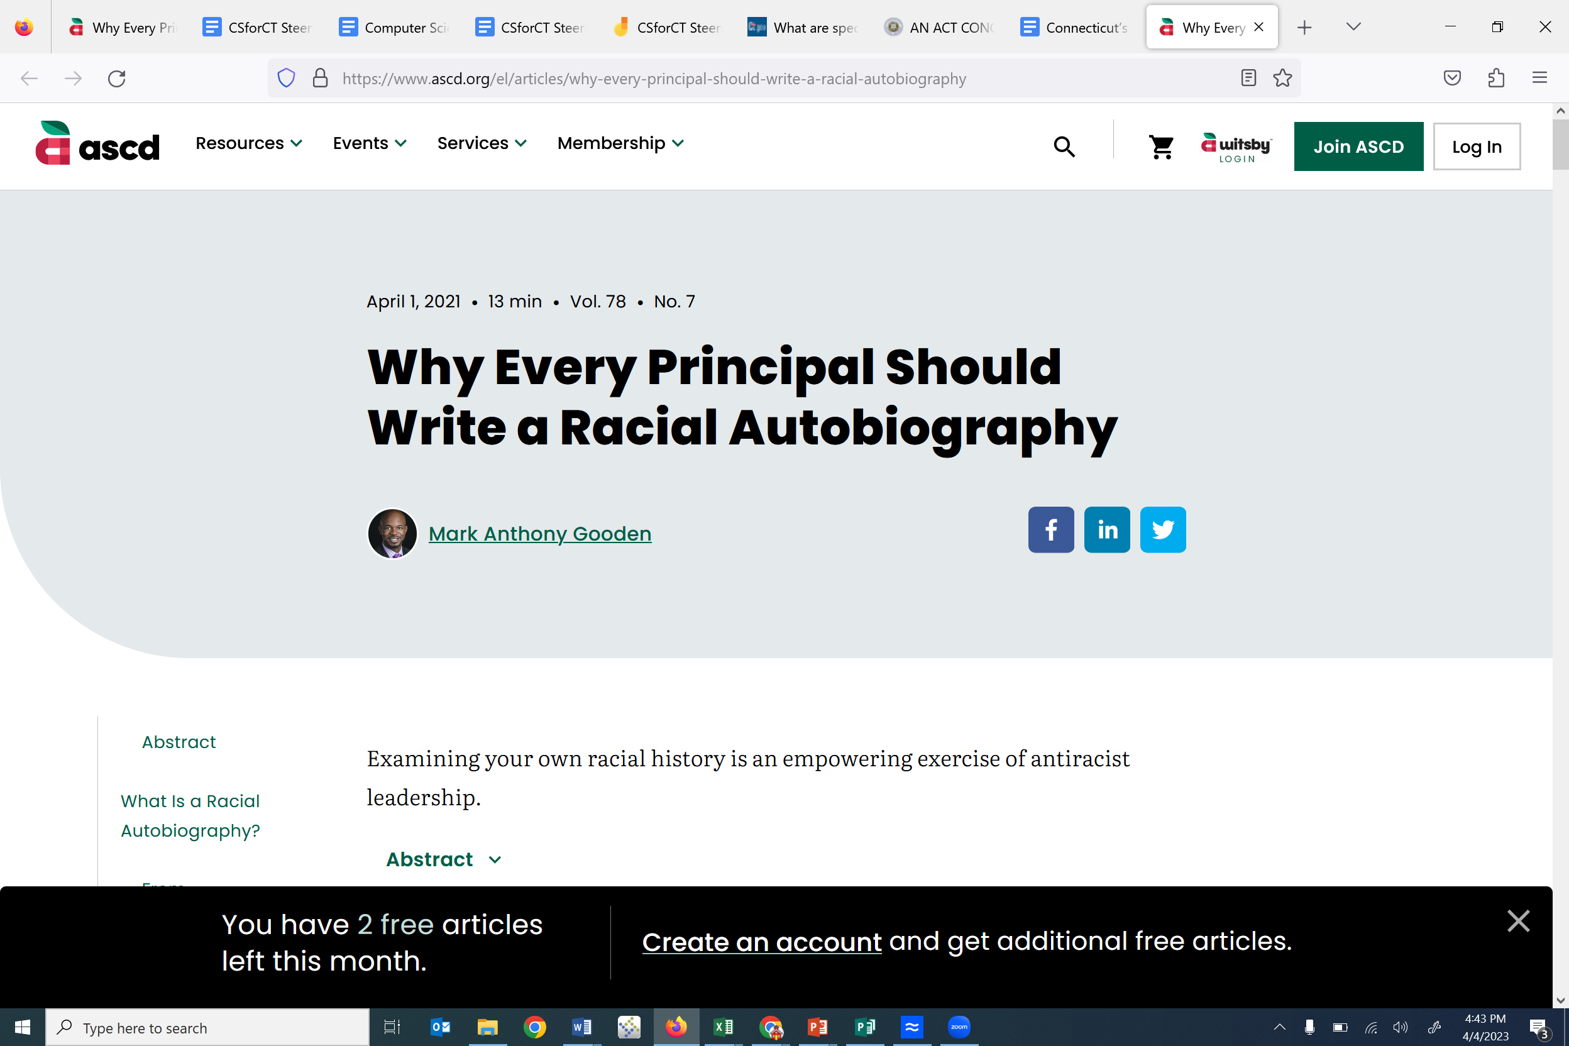

Slide 7
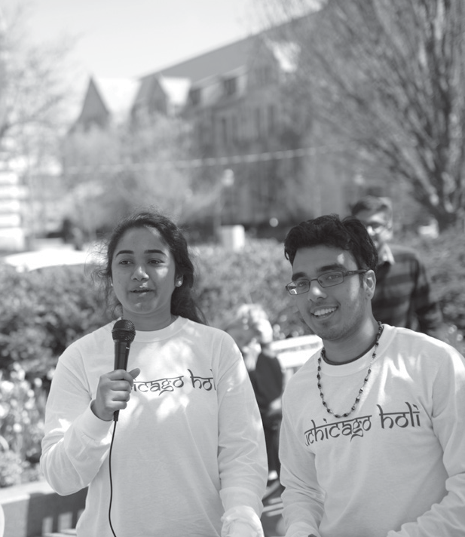
Using a Common Framework
Plainfield recommends approaching DEI using a framework prioritizing four strategy areas:
Create an infrastructure to support diversity and inclusion activities.
Foster a climate that is inclusive of all in the school community.
Develop and support
the people who comprise your community.
Engage in our surrounding community
INFRASTRUCTURE
CLIMATE
PEOPLE
community
Climate
Using this common framework across schools, a District can create customizable DEI plans
that create intentional, collective impact.

Slide 8
Initial Guidelines
Start building your DEI plan by completing these actions.
Identify Your DEI Team
Join with Others
Communicate Your DEI Efforts
Question:
Who in my school will lead and support our DEI planning efforts?
Action:
Identify your DEI planning team.
Details/Resources:
Identify a point-person or persons and team members from your school to address questions, collect suggestions, and spearhead communications that arise throughout the planning process.
Consider the composition of your team and how it represents
various perspectives, backgrounds, and experiences.
Question:
How can we communicate our commitment to diversity and inclusion internally and externally?
Action:
Add your school to the growing number of people working on a DEI plan.
Details/Resources:
Fill out the form below to let other schools on campus know you are participating.
Question:
How will we communicate ongoing DEI progress within our school?
Action:
Create a communication protocol for your DEI planning team that
articulates how you will communicate progress to your school.
Details/Resources:
Disseminate your DEI point-person’s contact info and other details for getting involved.
Set regular meeting times to discuss how to communicate progress on DEI efforts.
Include updates on your DEI efforts in newsletters, emails, and during school-wide meetings.

Slide 9
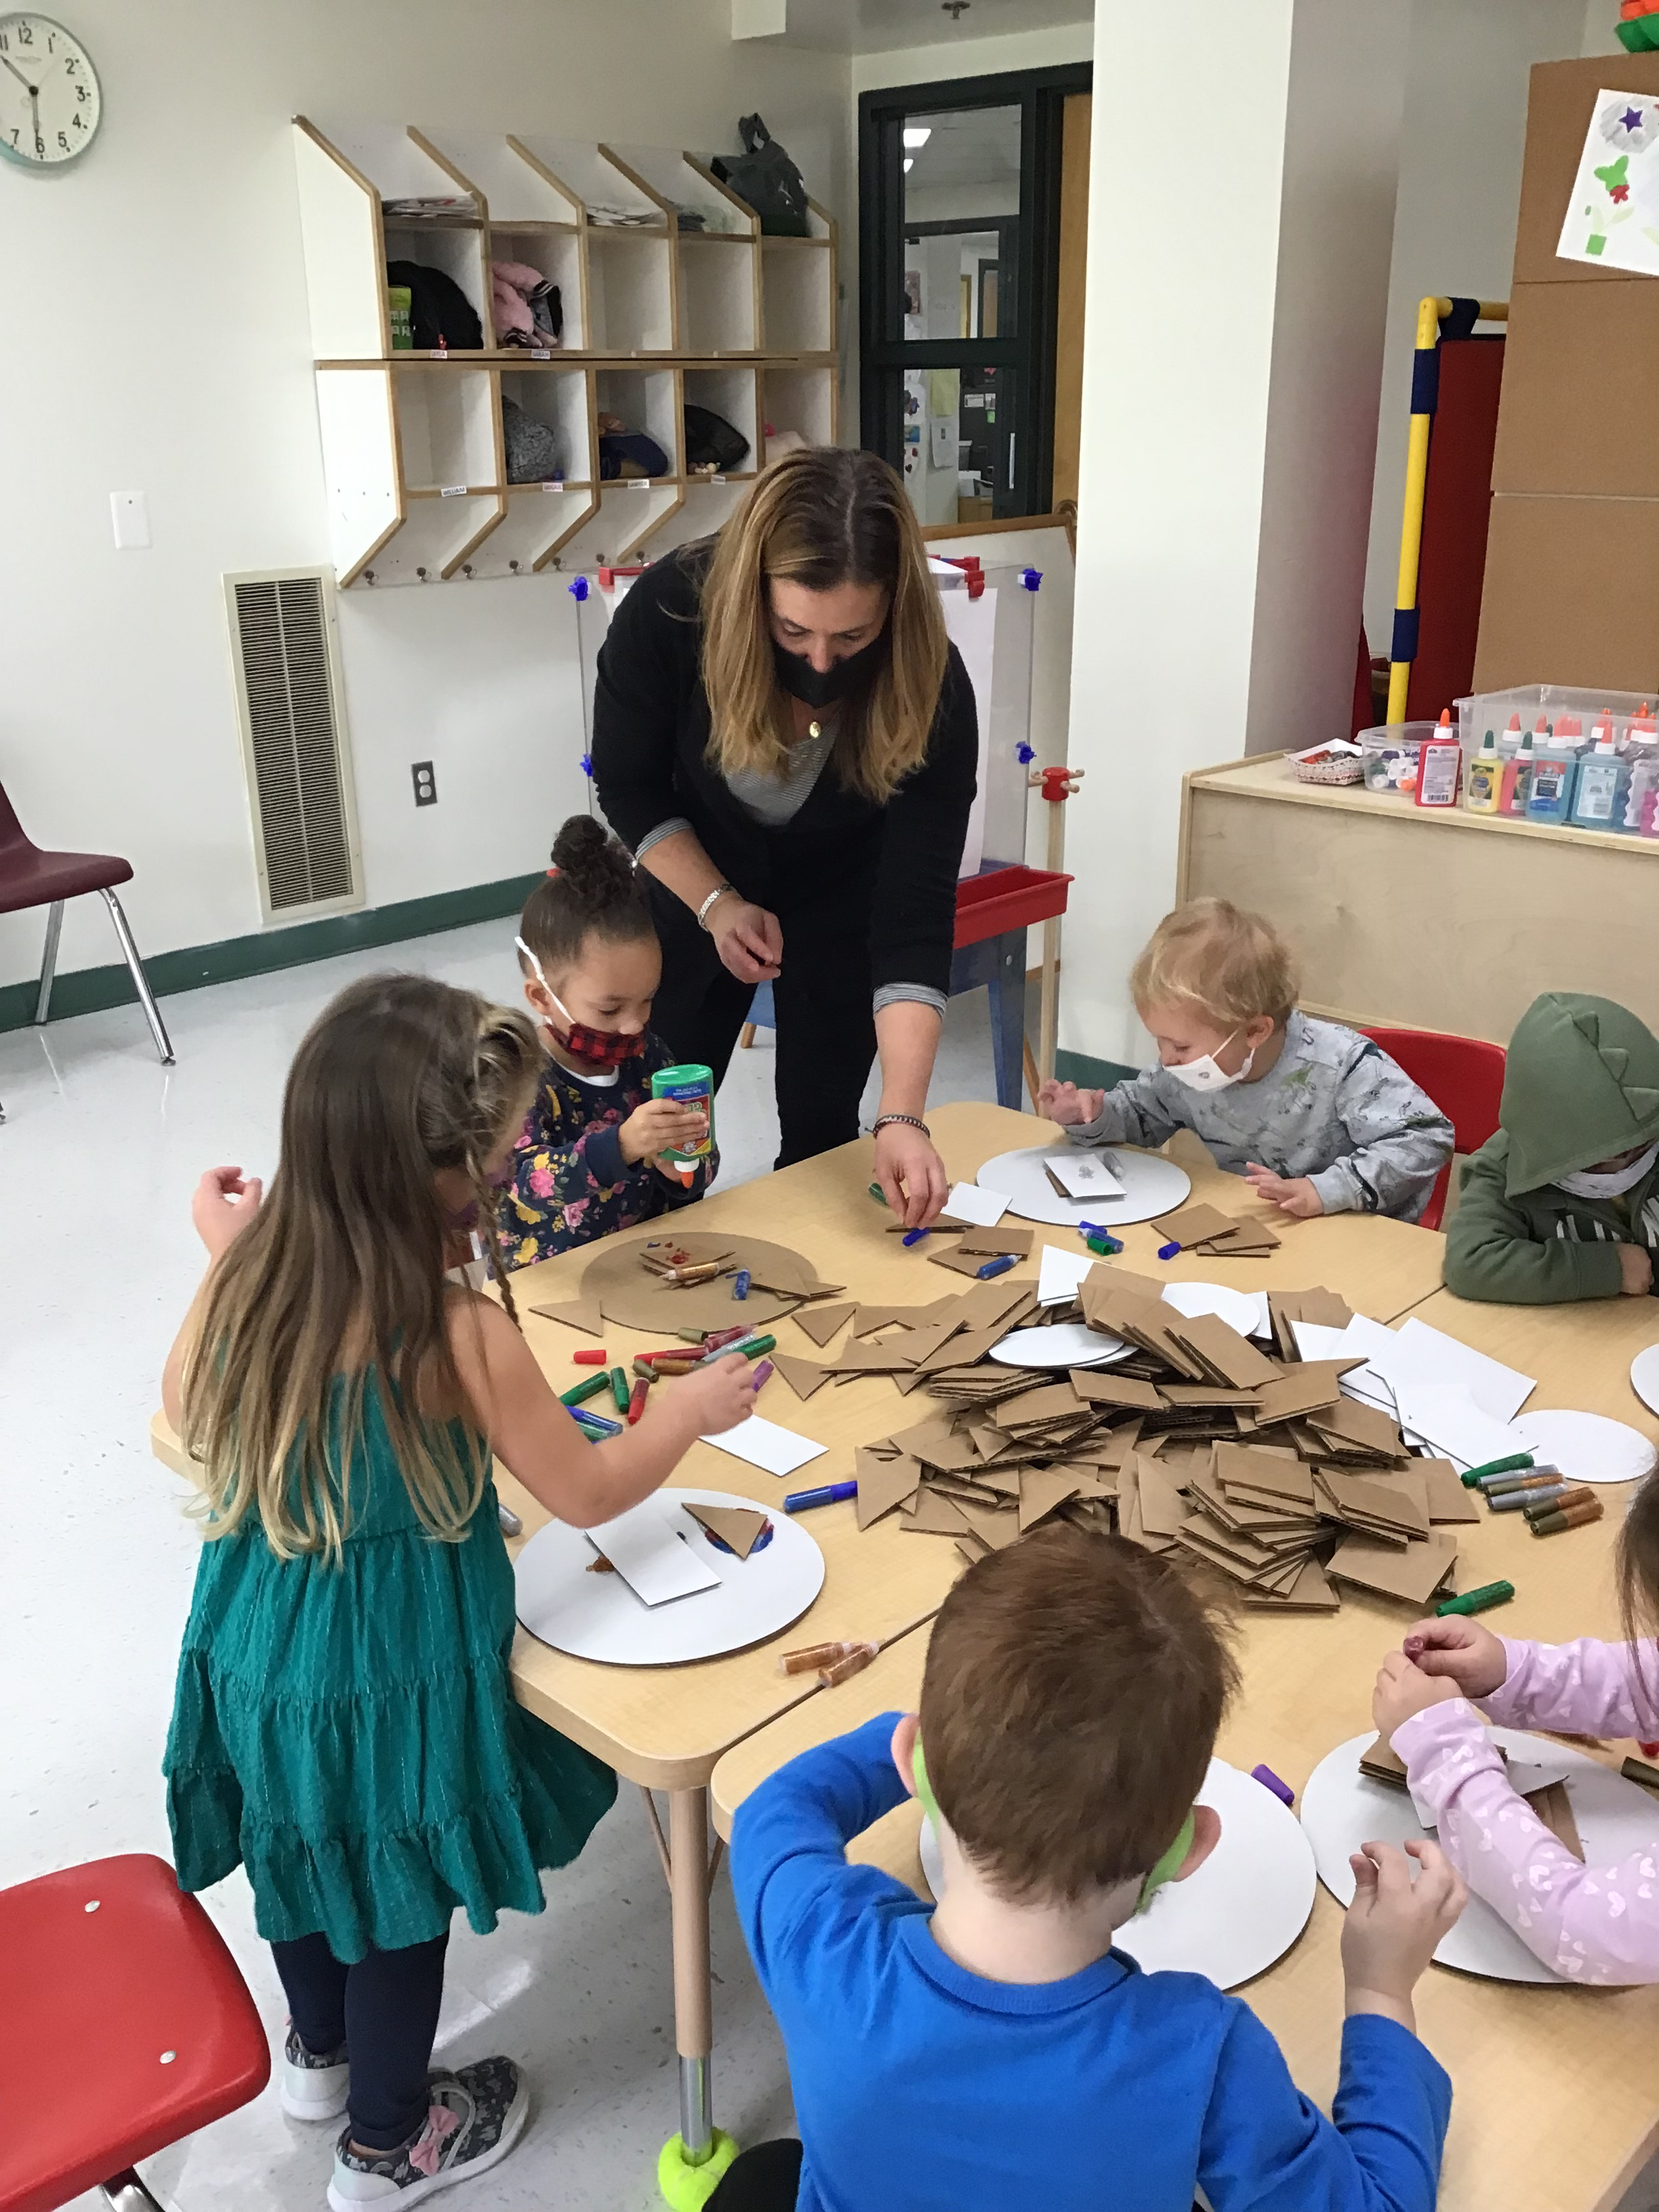
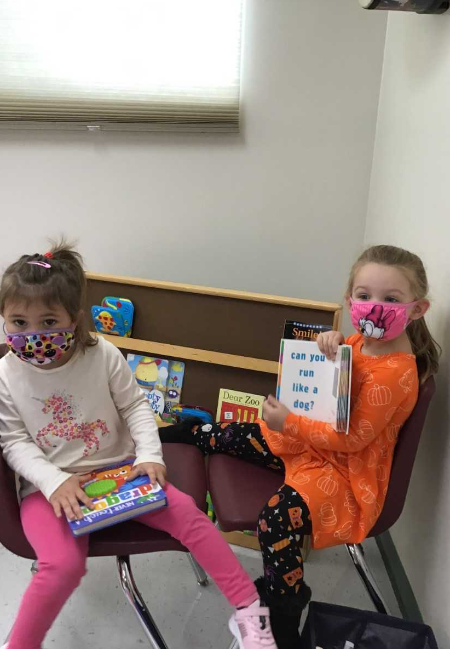
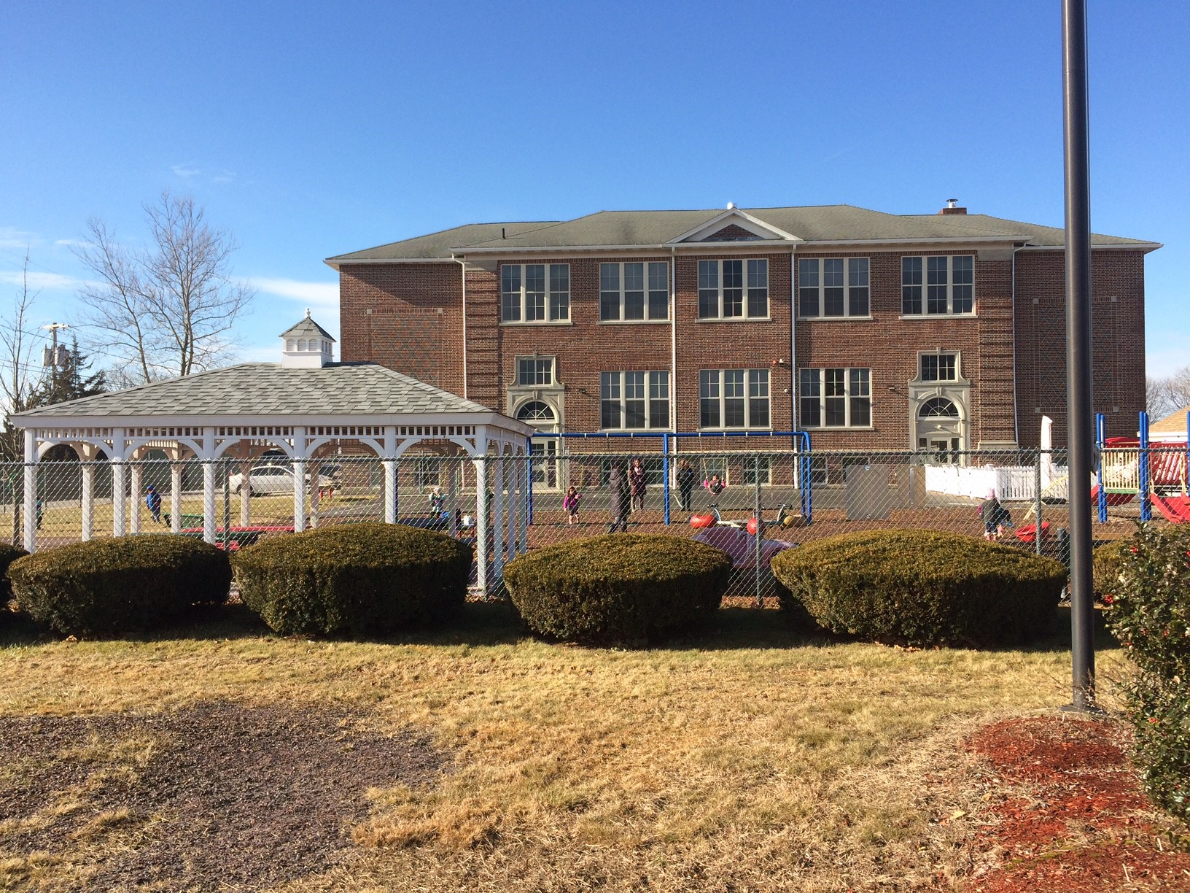
Who Are We?
2023 - 2024

Slide 10
Part 1: Diversity, Equity & Inclusion Reflection
Together with your planning team, take time to reflect on and answer these questions. Your values, assets and aspirations can guide the strategic activities of your group while helping you steer clear of any obstacles that might impede the planning process.
VALUES
How do you see DEI fitting into your school’s values?
ASSETS
What are existing strengths and initiatives you can leverage?
BARRIERS
What are current and potential challenges?
ASPIRATIONS
How do you hope your school will improve?

Slide 11
Understanding what a DEI Statement is:
How does a DEI commitment statement differ from an Equal Opportunity or Reasonable Accommodation statement?
Equal opportunity and reasonable accommodation statements are types of non-discrimination statements and required by law and university policy.
A diversity statement is not required by law or university policy, and instead it signifies a commitment to a diverse and inclusive workplace culture beyond legal mandates.
What should be included?
Consider your organization's answers to the following questions: What does DEI mean to your organization?
How does DEI relate to your organization's mission and values? Why is DEI important to your organization, now and in the future? How does your organization approach DEI, now and in the future? What are some specific DEI initiatives or actions, either ongoing or planned for the future?

Slide 12
Overview of Action Items by Strategy Area
Continue building your DEI plan by choosing one action in each strategy area.
INFRASTRUCTURE
State Your Commitment to Diversity
Evaluate DEI Visibility
Make a Timeline
CLIMATE
Build Inclusive Skills
Connect to Networks
Create a Welcoming Climate
Practice Inclusive Pedagogy
PEOPLE
Hire and Admit Inclusively
Mentor and Coach Individuals
Promote Equitable Labor Practices
Build and Maintain Pathways
COMMUNITY
Understand Cultural Context
Support Local Businesses
Reach Local Talent
Value Plainfield as an Asset
DEI Planning Toolkit · 5

Slide 13
INFRASTRUCTURE
Infrastructure refers to foundational structures—communications, policies, procedures, and roles.
These key components are essential to creating a system in which positive change can be made and sustained.
DEI Planning Toolkit · 6

Slide 14
Creating a Diversity Equity and Inclusion Statement
What is a DEI commitment statement?
Is a public commitment to fostering a diverse community and a culture of inclusivity Highlights your organization's DEI-related values and goals Sets DEI-related expectations for your community and its members A Diversity, Equity, and Inclusion (DEI) commitment statement:
How is a DEI commitment statement useful?
A DEI commitment statement shows the public and your community that diversity, equity, inclusion, and belonging are important to your organization. It can help with: Building trust between your community and leadership Increasing feelings of belonging within your community Recruiting diverse applicants

Slide 15
INFRASTRUCTURE
How can we begin creating a system that supports diversity and inclusion?
Choose one action below.
1. STATE YOUR COMMITMENT TO DIVERSITY
2. EVALUATE DEI VISIBILITY
3. MAKE A TIMELINE
4. GET INFORMED ABOUT DEI AT Plainfield
Question:
How can I let Plainfield and the public know that DEI is important to our school?
Action:
Think about the language you will use when talking about DEI and include it in your syllabi, website, and other materials.
Question:
How is my commitment to DEI made visible to those outside Plainfield?
Action:
Review your existing external-facing materials.
Question:
How can we stay on track with our DEI efforts?
Action:
Give your group deadlines to accomplish specific goals over a designated period of time.
Question:
How do I get a sense of the current state of DEI at Plainfield?
Action:
Become familiar with existing North East Connecticut DEI reports.
DEI Planning Toolkit · 7

Slide 16
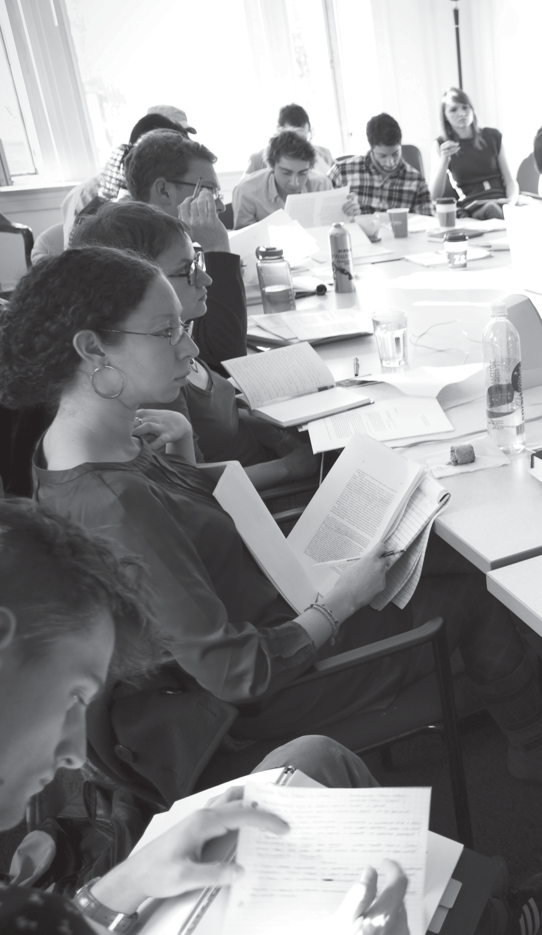
CLIMATE
Climate refers to the social environment we create and experience. Cultivating an inclusive climate is vital to building a community where all members have a sense of belonging and can participate
fully our schools.
DEI Planning Toolkit · 8

Slide 17
CLIMATE
How can we begin creating a system that supports diversity and inclusion?
Choose one action below.
1. INCREASE KNOWLEDGE AND BUILD SKILLS
2. CONNECT TO NETWORKS
3. CREATE A WELCOMING LOCAL CLIMATE
4. PRACTICE INCLUSIVE PEDAGOGY
Question:
How can individuals increase knowledge and build skills for creating an inclusive campus?
Action:
Learn more about topics related to inclusion and participate in skill-building trainings offered on campus.
Question:
How can we connect individuals with community of shared experience?
Action:
Share information about existing networks with current faculty, staff, and students.
Question:
How do we ensure that all people feel welcome in our school?
Action:
Become aware of, and
put into practice, inclusive activities, resources,
and policies.
Build our Survey
Question:
How do your curriculum, assessment, and classroom practices promote inclusion?
Action:
Review your school’s current learning opportunities and approaches with an eye toward diversity, accessibility, and inclusion.
DEI Planning Toolkit · 9

Slide 18
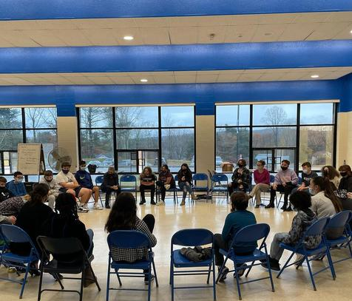
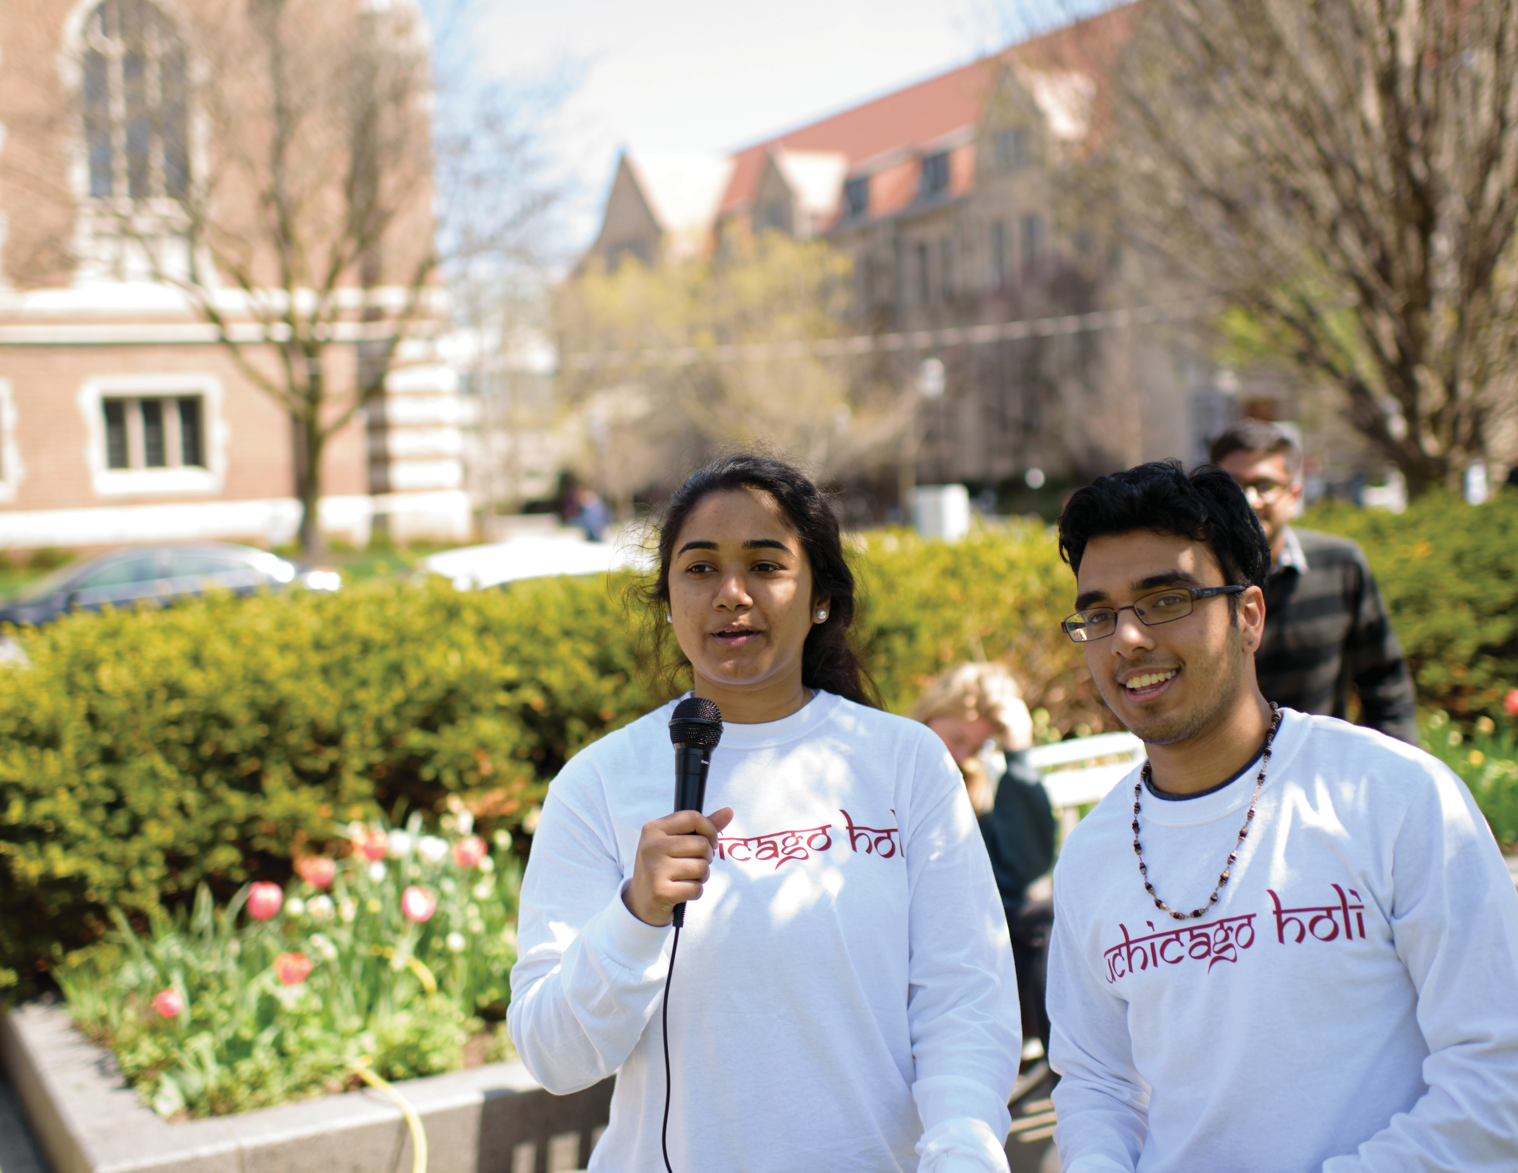
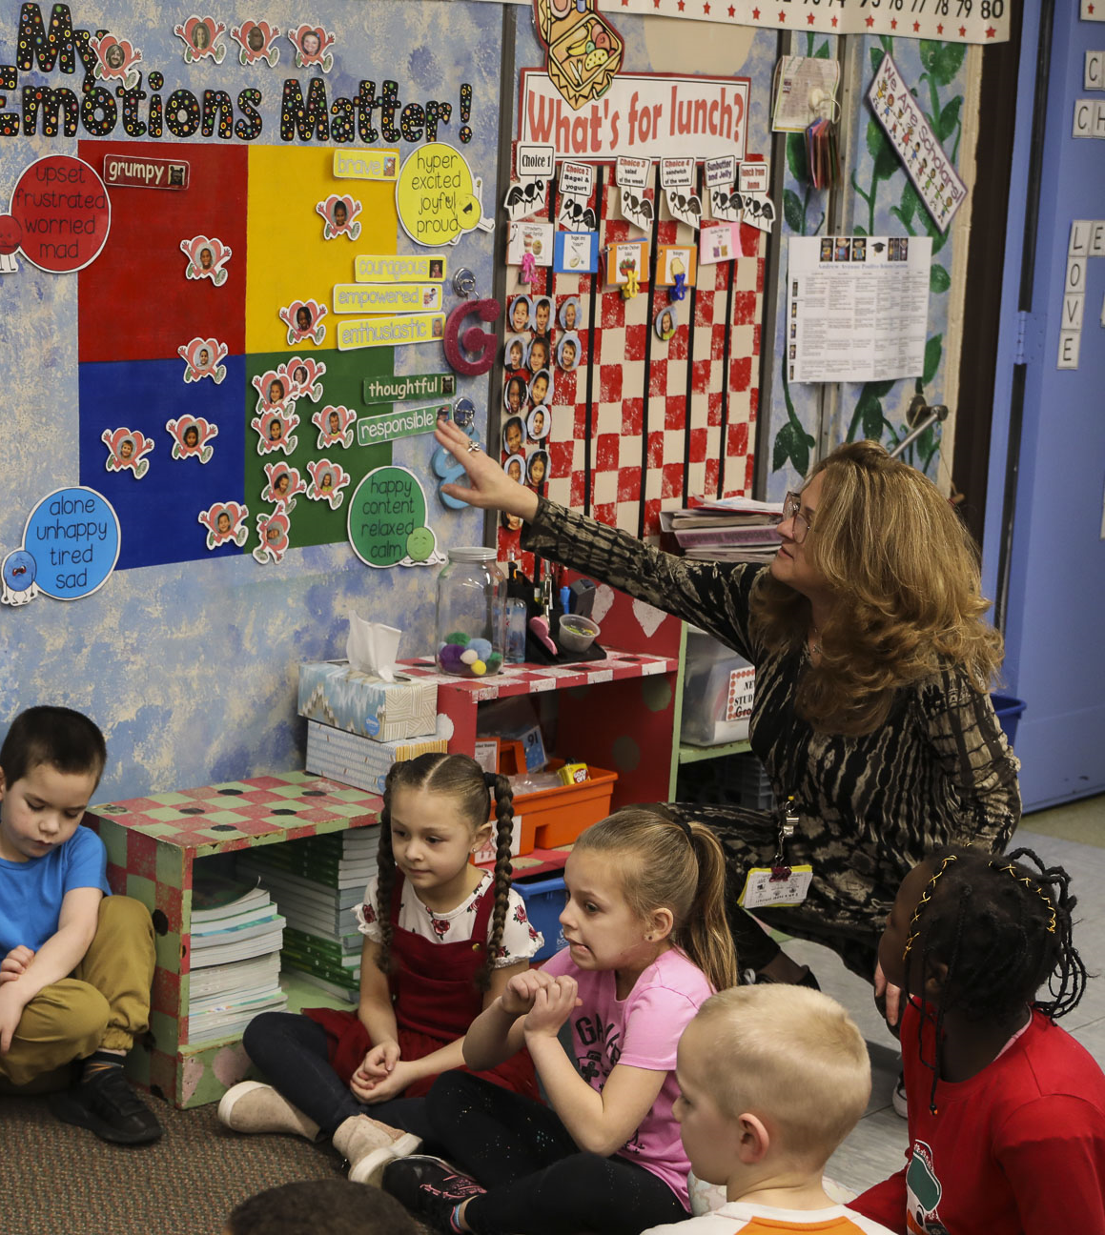
PEOPLE
People refers to creating a diverse and inclusive community comprised of people with different skills, identities, backgrounds, and experiences.
DEI Planning Toolkit · 10

Slide 19
PEOPLE
How can we begin creating a system that supports diversity and inclusion?
Choose one action below.
1. HIRE AND ADMIT INCLUSIVELY
2. MENTOR AND COACH
INDIVIDUALS
3. PROMOTE EQUITABLE EMPLOYMENT PRACTICES
4. BUILD AND MAINTAIN PATHWAYS
Question:
Do your school’s present and past faculty and staff hiring, and student admission practices, reflect Plainfield DEI values?
Action:
Ensure that all members of hiring committees are up to date on best practices for diversity.
Question:
How are faculty being supported throughout their academic career? How are new staff members welcomed to your school? Are staff members supported through their career trajectories? How are undergraduate and
graduate students being supported throughout their academic careers?
Action:
Review, revise, strengthen, or create mentoring programs for students, faculty, and staff.
Question:
Is the work of your school being divided equitably?
Action:
Review the amount of teaching, service, mentoring, or administrative responsibilities that individuals in your school take on.
Question:
How is your department contributing to building pathways of talented candidates for your field?
Action:
Strengthen your commitment to building pathways to
the professoriate or to professional success for underrepresented groups.
DEI Planning Toolkit · 11

Slide 20
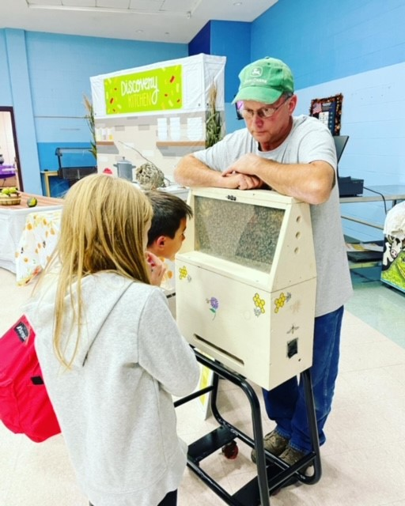
Community
community refers to building relationships with local and global partners. Our School, our city, and our networks will achieve more by learning and growing together.
DEI Planning Toolkit · 12

Slide 21
COMMUNITY
How can we engage with our local community to build meaningful partnerships and create positive impact?
Choose one action below.
1. UNDERSTAND CULTURAL CONTEXT
2. SUPPORT LOCAL BUSINESSES
3. REACH LOCAL TALENT
4. VALUE Plainfield AS AN ASSET
Question:
How can my school learn about Plainfield’s history related to DEI ?
Action:
Explore Plainfield’s cultural history
Connect with regional historical teams; .
.
Question:
How can we connect to local commerce?
Action:
Choose local vendors for events and activities.
Question:
Do our job requisitions reach local candidates?
Action:
Make a to think about how upcoming job searches could include more local candidates in the pool.
Question:
Is our school valuing the city of Plainfield as an asset?
Action:
Draw the resources of the city into the work of your school.

Slide 22
Our school’s DEI Strategic Plan
Initial Guidelines
Join with Others
Identify Your DEI Team
Communicate Your DEI Efforts
Infrastructure
State Your Commitment to Diversity Evaluate DEI Visibility
Make a Timeline
Get Informed about DEI at Plainfield
Climate
Increase Knowledge and Build Skills Connect to Networks
Create a Welcoming Local Environment Practice Inclusive Pedagogy
People
Hire and Admit Inclusively Mentor and Coach Individuals
Promote Equitable Labor Practices Build and Maintain Pathways
Community
Understand Cultural Context Support Local Businesses Reach Local Talent
Value Plainfield as an Asset

Slide 23
Planning Notes
Consider the questions below or use this space for any additional thoughts or questions you may have.
What resources (people, support, materials) do you need to help you or your school successfully execute your selected actions?
How do you plan to acquire these resources?
What resistance may you encounter? How might you gain collaboration?
What does success look like? What criteria will you use to evaluate your success?

Slide 24
Ending Well

